Slide 1

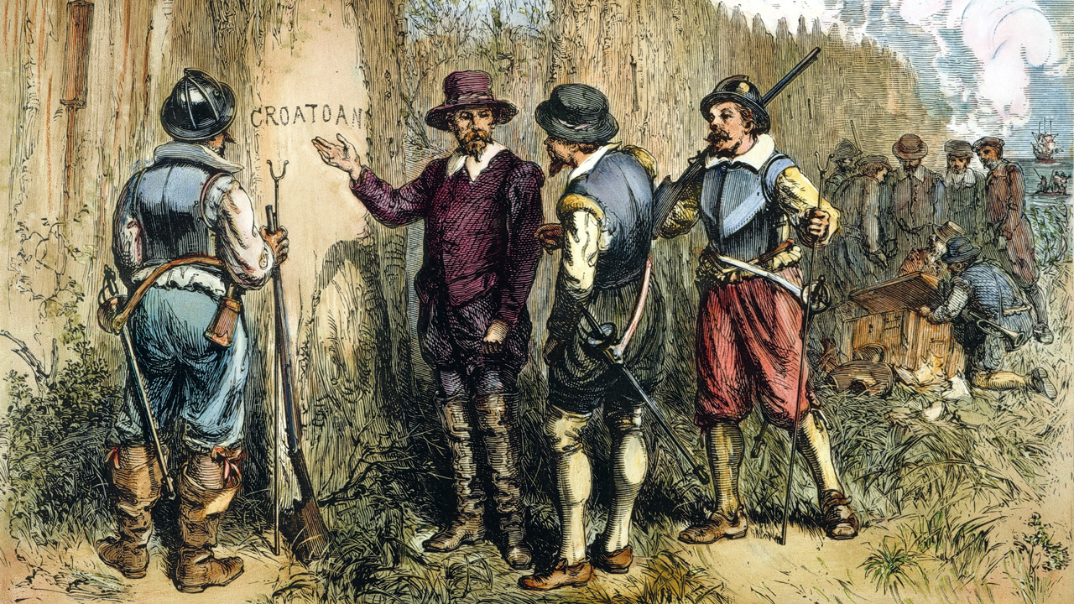
The Lost Colony
of Roanoke

Slide 2
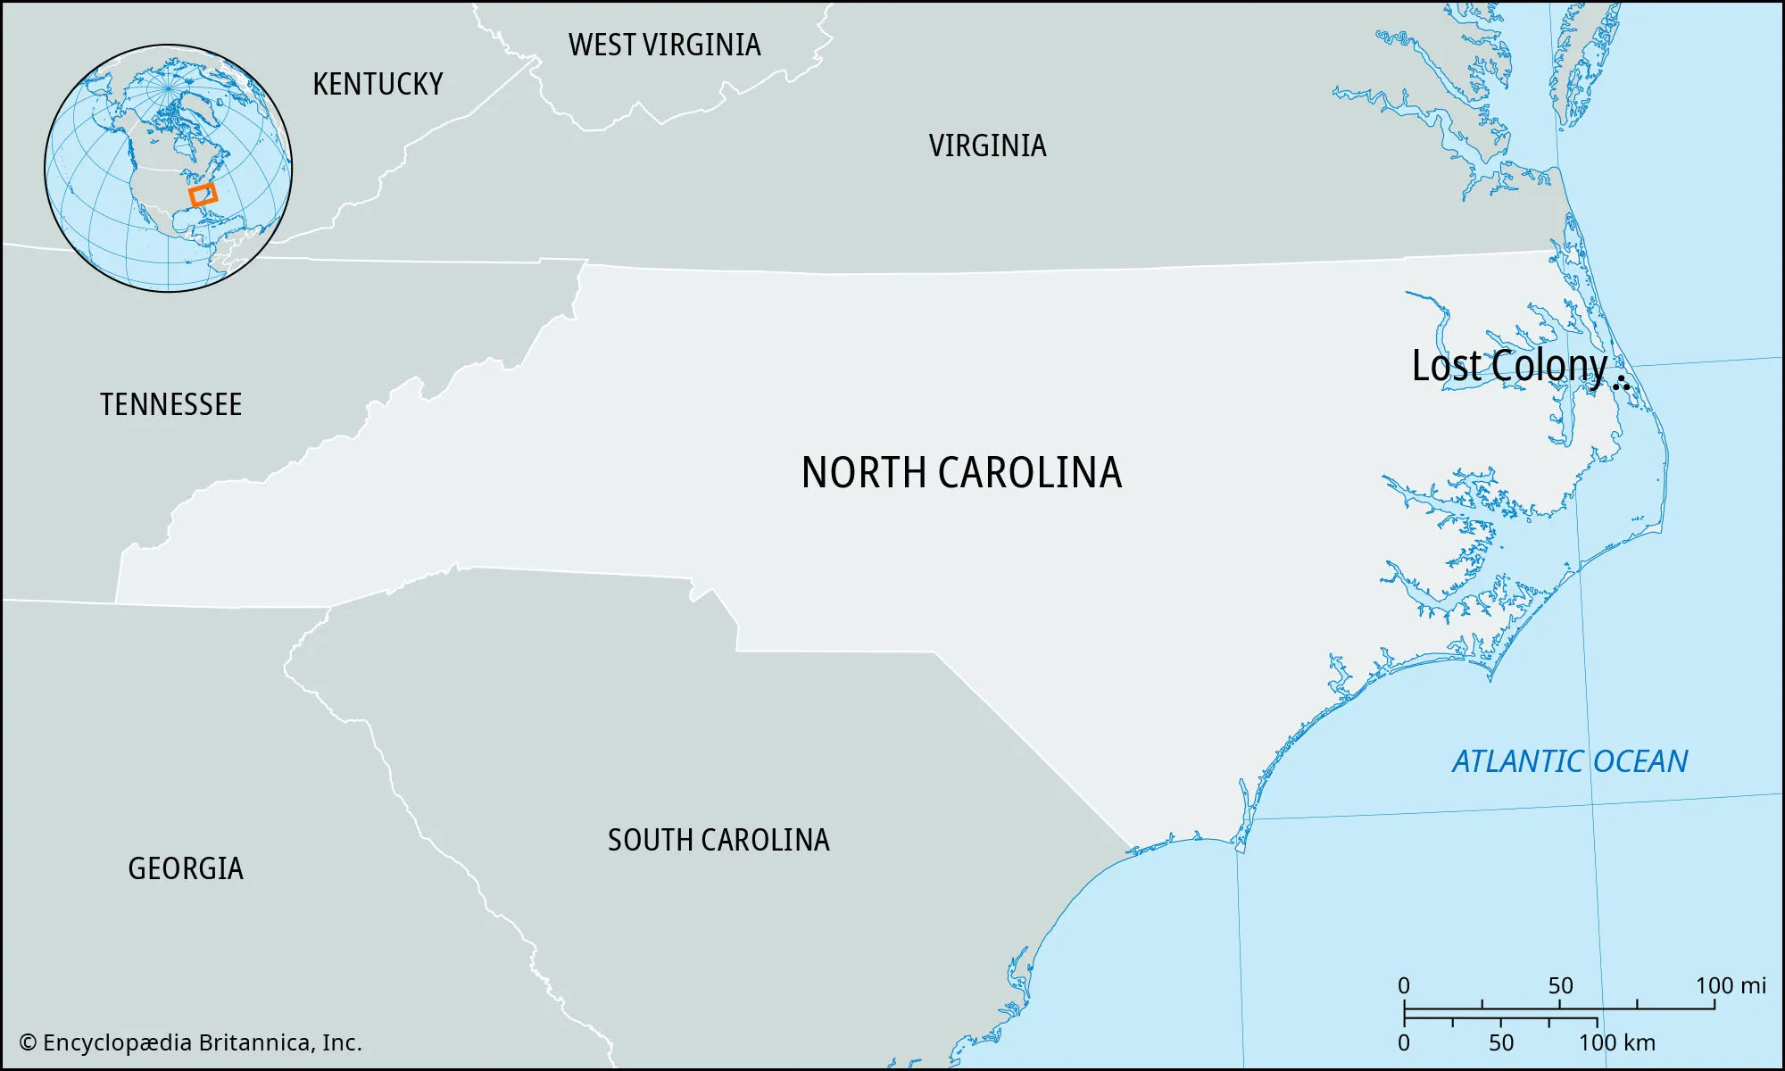

Slide 3
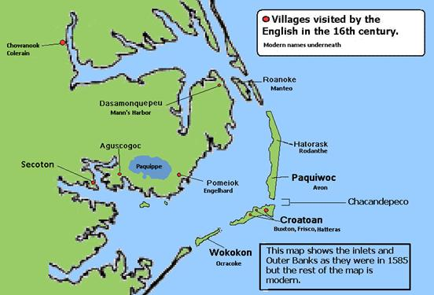

Slide 4
Theory #1-
The Settlers Left
-They built a boat and tried to sail back to England.
-They resettled somewhere along the Chesapeake Bay.

Slide 5
Theory #2-
The Settlers Joined the Natives
-They went to live with the Croatoan Natives to the south.
-They went to live with Natives on the mainland.

Slide 6
Theory #3-
Disaster
-They were overcome by a powerful Atlantic storm that wiped them out.

Slide 7
Theory #4-
Attacked by Natives
-The first settlement at Roanoke was attacked by hostile Natives, so some historians believe the same happened to the Lost Colony settlers.

Slide 8
Theory #5-
Attacked by Spanish
-The Spanish didn’t want any other country settling in America, so they wiped out the settlers of Roanoke.

